Slide 1
NAME:CHIMA OKWUOKEI STANISLAUS CSC 102 CLASS PROJECT 3,4 and 5

Slide 2
PSEUDOCODE FOR PROJECT 3
INPUT TO PAU
IF Package is 10kg or more, pay ₦2000.00
IF Package is less than 10kg,pay ₦1500.00
INPUT TO EPE
IF Package is 10kg or more, pay ₦5000.00
IF Package is less than 10kg, pay ₦4000.00

Slide 3
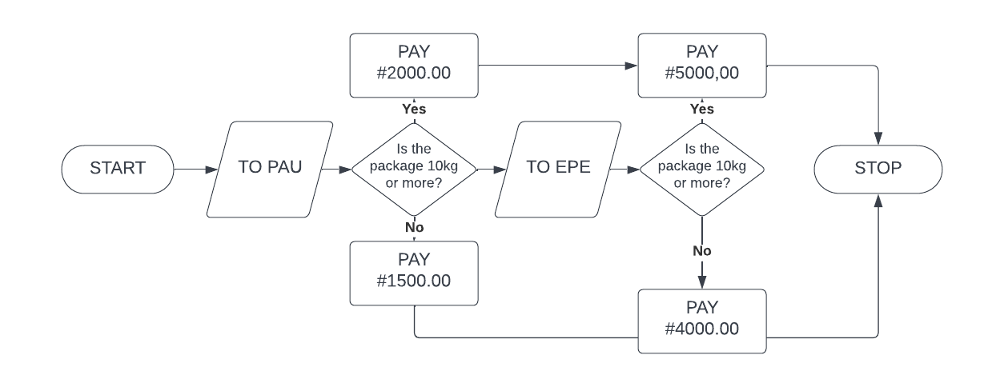
FLOWCHART FOR PROJECT 3

Slide 4
PSEUDOCODE FOR PROJECT 4
INPUT JAMB RESULT
IF SCORE IS 230 OR MORE,INPUT ADMIT
IF SCORE IS LESS THAN 230,INPUT DO NOT ADMIT
INPUT WASSCE RESULT
IF AT LEAST 5 CREDITS WERE GOTTEN IN 5 KEY SUBJECTS,INPUT ADMIT
IF LESS THAN 5 CREDITS WERE GOTTEN IN THE REQUIRED 5 KEY SUBJECTS,INPUT DO NOT ADMIT
INPUT INTERVIEW REPORT
IF PASSED,INPUT ADMIT
IF FAILED, INPUT DO NOT ADMIT

Slide 5
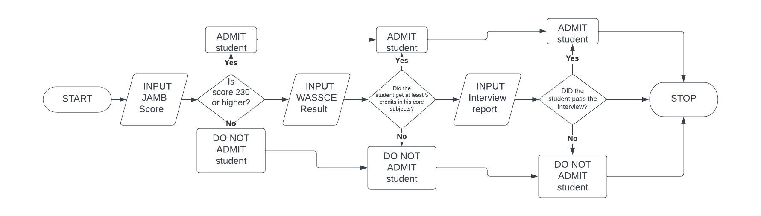

Slide 6
PSEUDOCODE FOR PROJECT 5
INPUT BOY ,WITH A FLOWER IN HIS HAND,BEGINS MOTION AT POINT (0,0) FACING EAST
MOVE GIRL 2 PLACES ON THE VERTICAL AXIS FACING WEST
MOVE BOY TO WHERE THE GIRL IS
MOVE GIRL 3 PLACES ON THE HORIZONTAL AXIS, AND 2 PLACES ON THE VERTICAL AXIS
COMMAND GIRL TO PLANT THE FLOWER INTO THE VASE
MOVE GIRL TWO STEPS SOUTH FACING EAST

Slide 7
